Slide 1
Intellectual Revolutions that Defined Society
Module 1 – Lesson 1 (Part 2)

Slide 2
Intellectual Revolution
is a movement about enlightenment
initiated during 17th century where people are more driven by the new discoveries in science and technology and cultural relativism resulting from the explorations
a revolution of people where faith in the power of human reason should not be set aside and the great premium was actually placed on the discovery of the truths through observations of nature more willingly than just through the study of authoritative sources

Slide 3
Intellectual Revolution
where the scientific experiments and philosophical writing became “in” or trendy.
an era marked by questioning of traditional dogmas / values
emphasizes the idea of universal human progress, the most pragmatic systems in science as well as free use of reason, logic, and critical thinking

Slide 4
Definition of Intellectual Revolution
Greek speculation about the "nature" in the period before Socrates (roughly 600 to 400 BCE)
Hence, the alternative, technical terms are “pre Socratic” or "non-theological" or "first philosophy“
Three Characteristics of this Philosophy:
The world is a natural whole
There is natural order
Humans can ‘discover’ those laws

Slide 5
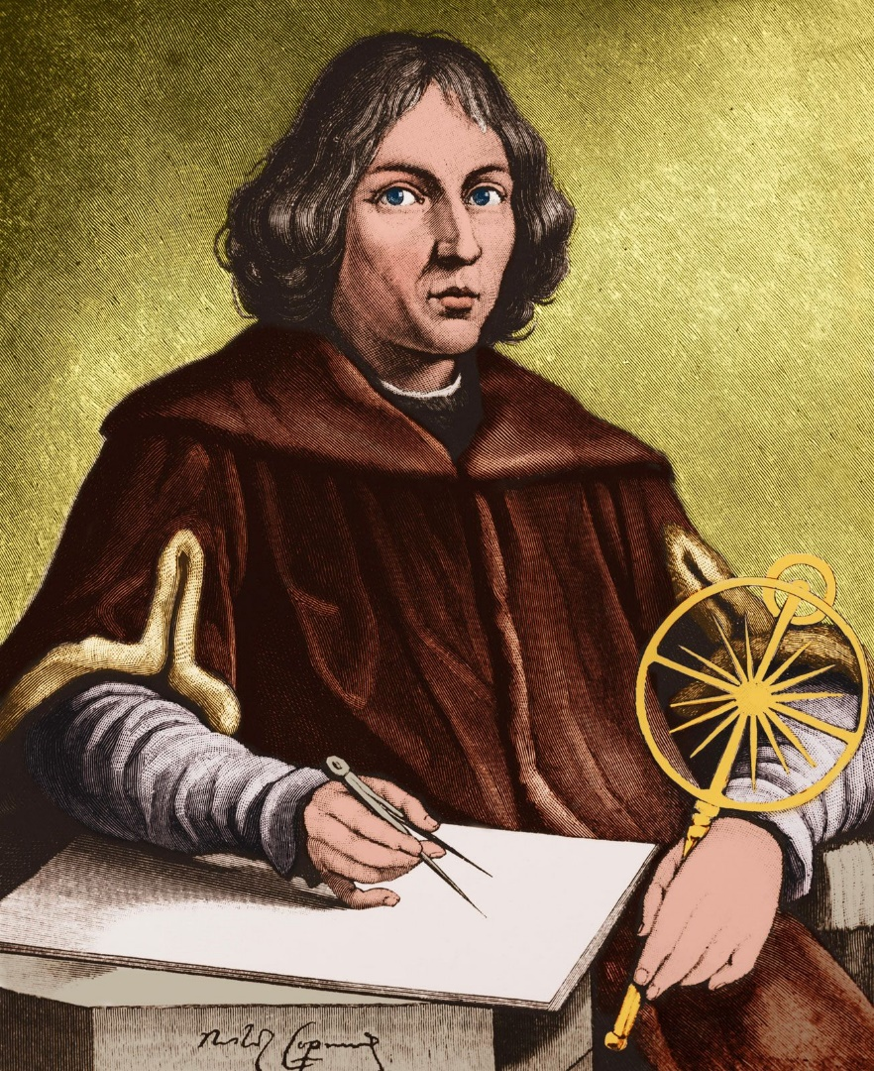
Copernican Revolution
articulated by the Polish astronomer Nicolaus Copernicus in the 16th century
was a Renaissance polymath, active as a mathematician, astronomer, and Catholic canon
It is a shift in the field of astronomy from a geocentric understanding of the universe, centered around Earth, to a heliocentric understanding, centered around the Sun

Slide 6
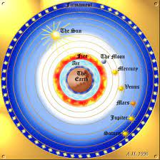
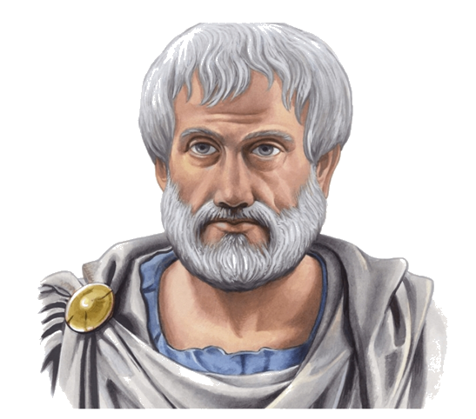
Copernican Revolution
Aristotle, however, believe that the earth is the true center of all the orbitals carrying the heavenly bodies and all motions are uniform and unchanging

Slide 7
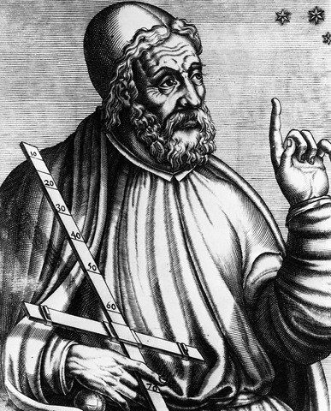
Copernican Revolution
Claudius Ptolemy accepted Aristotle's idea that the Sun and the planets revolve around a spherical Earth, a geocentric view. Ptolemy developed this idea through observation and in mathematical detail.

Slide 8
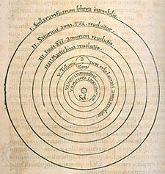
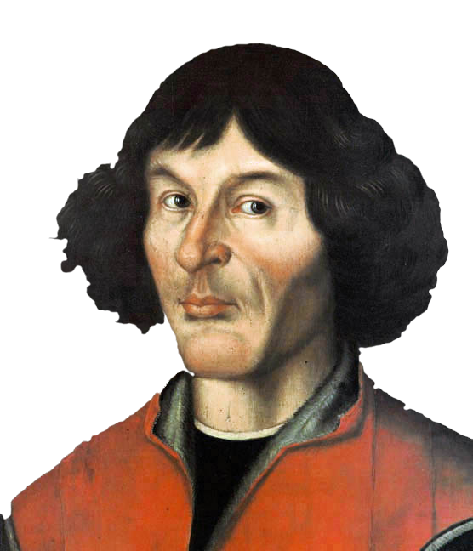
Copernican Revolution
Copernicus initially outlined his system in a short, untitled, anonymous manuscript that he distributed to several friends, referred to as the Commentariolus.
Copernicus’s book De Revolutionibus Orbium Coelestium (“On the Revolutions of the Heavenly Spheres”), published in 1543
became a standard reference for advanced problems in astronomical research, particularly for its mathematical techniques

Slide 9
Copernican Revolution
Copernicus adopted a heliocentric view because it better explained the motions of the heavens mathematically. This view had the Earth and other planets moving in circles around the fixed Sun.
marked the start of a broader Scientific Revolution that set the foundations of modern science and allowed science to flourish as an autonomous discipline within its own right

Slide 10
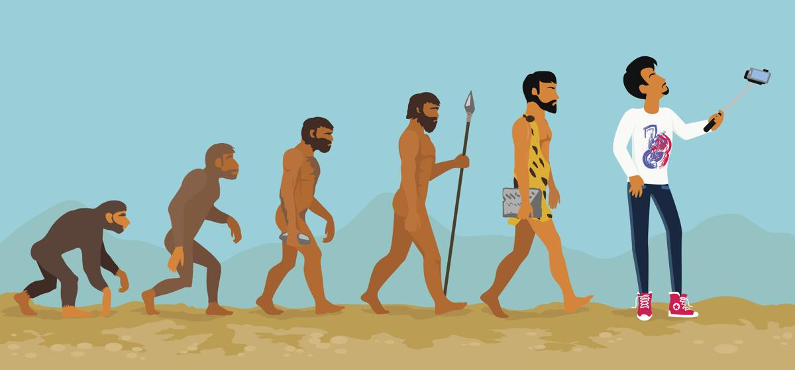
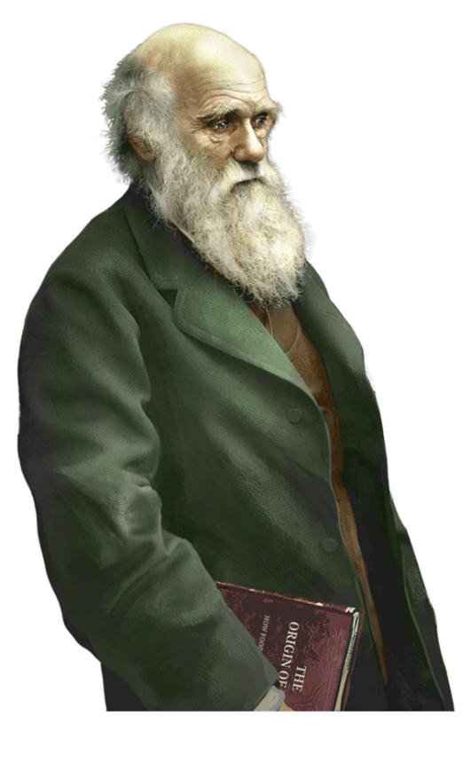
Darwinian Revolution
enunciated by Charles Robert Darwin
was an English naturalist, geologist and biologist, best known for his contributions to evolutionary biology. His proposition that all species of life have descended from a common ancestor is now widely accepted and considered a fundamental concept in science.

Slide 11
Darwinian Revolution
In 1859, there was a groundbreaking revolution in both the scientific and religious realms: the Origin of Species, authored by Charles Darwin, was published. The book changed how people approach biology forever, and has fundamental impacts on modern science, religion, and other aspects of the society.
Darwin’s revolutionary theory was that new species arise naturally, by a process of evolution, rather than having been created—forever immutable—by God.

Slide 12
Darwinian Revolution
Suggested that all organisms are related and have descended from a common ancestor
proposed the “Natural Selection”
Natural Selection
- organisms survived due to random genetic mutations leading to the preservations of their descendants
- “survival of the fittest”, the better adapted a species is, the more fitted it is to reproduced

Slide 13
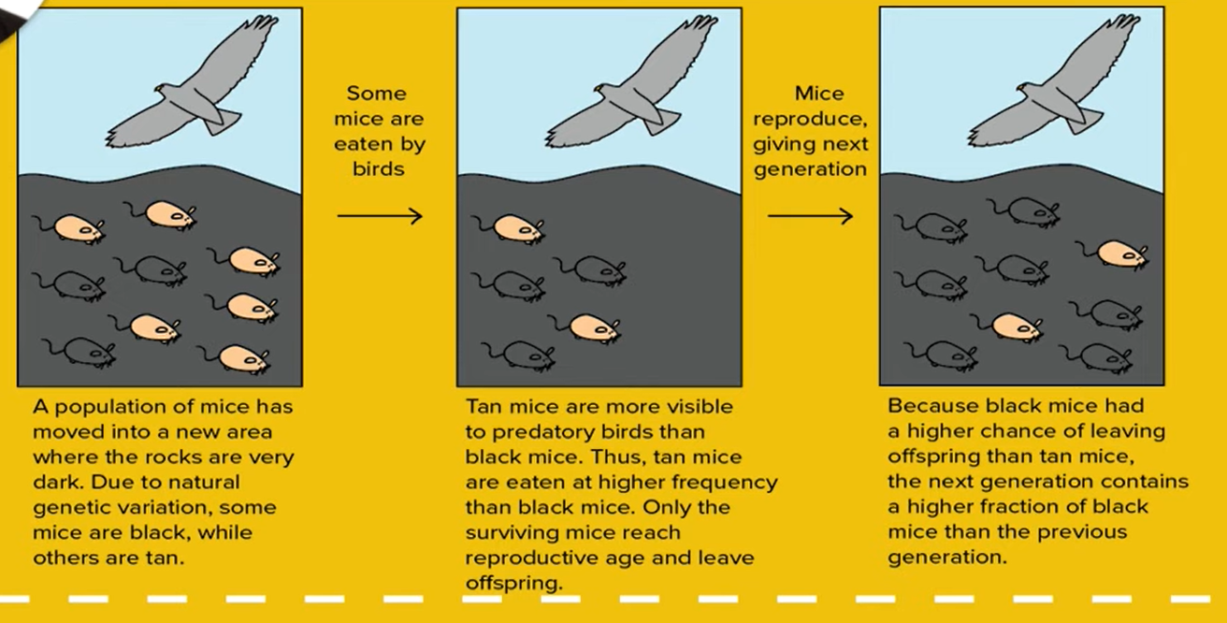
Darwinian Revolution

Slide 14
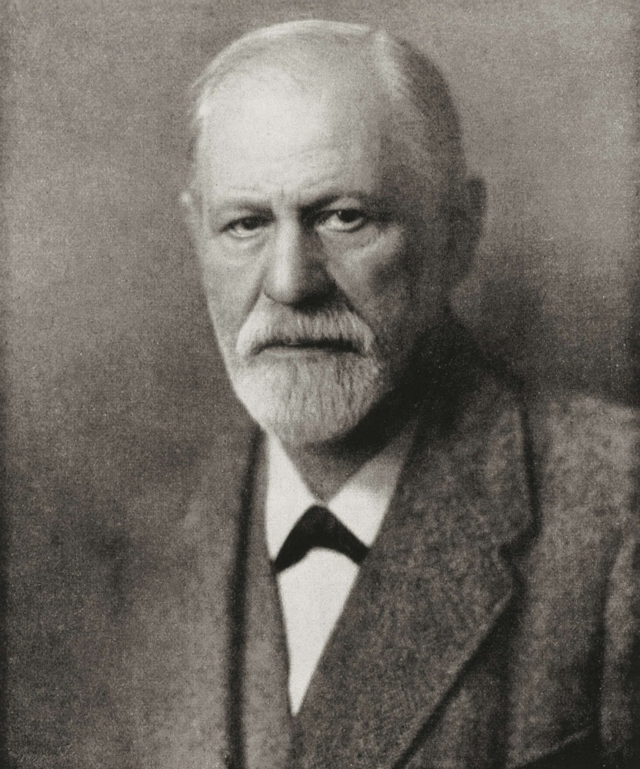
Freudian Revolution
Articulated by Sigmund Freud who was an Austrian neurologist and the Founder of Psychoanalysis,
a clinical method for evaluating and treating pathologies in the psyche through dialogue between a patient and a psychoanalyst

Slide 15
Freudian Revolution
believed that when people explain their behavior, they rarely gave a true account of their motivation, not because they are deliberately lying, but because they are more adept at self-deception
Freud’s structural theory of personality emphasizes the role of unconscious psychological conflicts in shaping behavior and personality

Slide 16
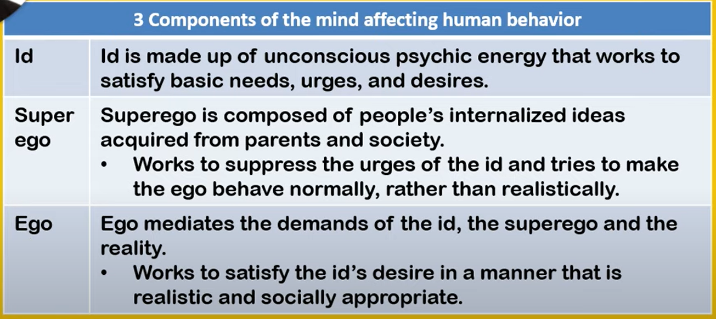
Freudian Revolution

Slide 17
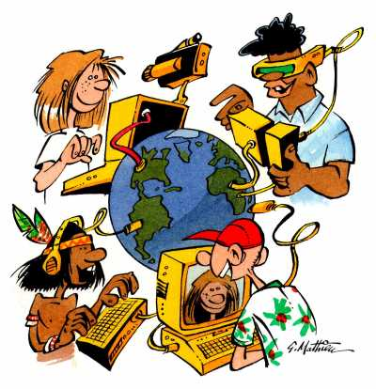
Information/Digital Revolution
paradigm shift from mechanical to digital age
it changes various aspects of life with efficiency as the primary aim

Slide 18
Information/Digital Revolution
Before Computers (BC) | After Digital (AD)
Typewriter | Word processor
Filling cabinet | Database
Mail sent via trucks | Emails and Faxes
Goods bought at store | Online
Paid with cash | Electronically, Credit/Debit Cards
Phone booths | Cell phones

Slide 19
Information/Digital Revolution
1. Economic Shift
Creative Destruction
a term coined by Joseph Schumpeter, referring to a process through which something new brings about the destruction of whatever existed before…a shift from the old to the new
in his book “Capitalism, Socialism and Democracy”, Schumpeter describes it as “the process of industrial mutation that incessantly revolutionizes the economic structure from within, incessantly destroying the old one, incessantly creating a new one”

Slide 20
Information/Digital Revolution
initially, the business sectors during the time of industrial revolution was governed by the concept of mass production…increasing the labor force…an asset-based means of production
now, more and more businesses are leveraging on digital technology for a competitive advantage… becoming automated…an information-based means of production

Slide 21
Information/Digital Revolution
b. Knowledge Industries
industries that are intensive in their input of technology such as telecommunications, software development, medical equipment and pharmaceutical research, and business innovators, to name a few.
their competitive advantage comes from innovative and creative people thus establish their business in areas more suited for information work

Slide 22
Information/Digital Revolution
2. Employment Shift
manual labor force is decreasing as jobs start to require knowledge and creativity in the light of advance digital technology
3. Education Shift
- shifting teaching methods, techniques, and contents to concentrate more on critical reasoning skills to be able to take tons of information and synthesize it better- graduates become more competitive in the field of information

Slide 23
Information/Digital Revolution
4. Political Shift
transform the manner in which governments
interact and provide services to the citizens
manage government supply chains
conduct internal government processes
control the content and flow of information in society
- decentralization of function from exclusive sovereignty state to supranational governments (governments made up of different sovereign states) and intergovernmental organizations

Slide 24
Information/Digital Revolution
5. Moral or Ethical Shift
lead to psychological and physical issues
contribute to more serious health conditions
have a more significant impact on developing children and teenagers

Slide 25
Activity No. 3 - Standing on the Shoulders of Giants
Instructions: You will be assigned to a group, these are ancient times (Group 1), middle ages (Group 2), modern/information ages (Group 3) and anytime in the Philippines (Group 4). The following are what you are going to do after you know your group.
Choose one major achievement of S&T in the group you belong. Take note that NO MEMBER SHOULD PICK THE SAME ACHIEVEMENT (the achievement could be an invention, method introduce, discovery and anything under the sun that has something to do with science and technology), and that the achievements must come from different fields. Show a picture and write about the following:
1. what is that achievement;
2. how it works; and
3. what pushed it to be invented or achieved (historical antecedent).

Slide 26
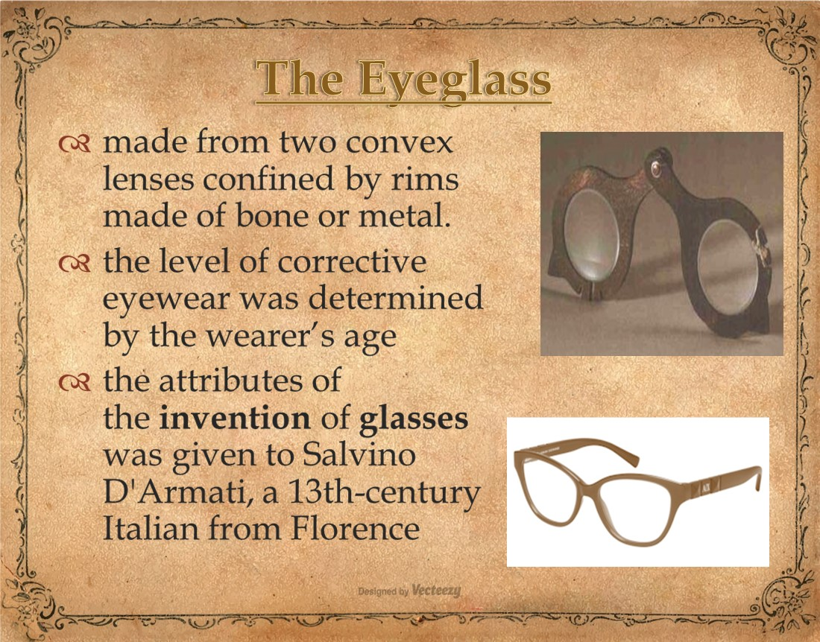

Slide 27

Reflection Paper No. 3
Write your reflection on this question:
“How important or significant are the contributions of the revolutions to the evolution of science?”

Slide 28


